Slide 1
Standards for Mathematical Practice Overview
College and Career Readiness
Notes:
Instructor Notes: 30 seconds
In our ongoing effort to ensure that our students are college and career ready, we will continue our work with the Common Core State Standards.
Today we will begin to unpack the Common Core practice standards.

Slide 2
District-Wide 2013-14 Math Goals
Collaboratively plan, deliver, reflect upon, and revise instruction that differentiates for all learners and includes the Standards for Mathematical Practice:
MP1 - Make sense of problems and persevere in solving them
MP3 - Construct viable arguments and critique the reasoning of others
MP4 - Model with mathematics
Build understanding of the Common Core instructional shifts focus, coherence, and rigor
Integrate technology in support of teaching and learning
Notes:
Instructor Notes: 1 minute
Listed are the 2013-14 District math goals for schools. Our work in this session will be guided these objectives.
Review slide
Primarily we’ll be focusing on the cycle of plan, deliver, reflect, & revise. Jay McTighe and Grant Wiggins (Understanding by Design - UbD), cite identifying desired results as the first of three stages in strategic backwards planning. Today we’ll be working to understand the standards, our desired results.
Additional Facilitator Information:
Focus: Instruction is focused on grade level standards.
Phil Daro on Focus in Math http://vimeo.com/45730600
The Importance of Focus http://www.youtube.com/watch?v=2rje1NOgHWs&list=PLD7F4C7DE7CB3D2E6
Coherence: Instruction should be attentive to learning across grades and linking major topics within grades.
Rigor: In major topics, pursue with equal intensity conceptual understanding, procedural skill and fluency, and applications.

Slide 3
Session Outcome
Collaboratively define Common Core Standards for Mathematical Practice 1, 3, and 4
Notes:
Instructor Notes: 30 seconds
Review slide

Slide 4
College and Career Readiness
Practice
Standards
Common
Core
Mathematics Standards
Content
Standards
Notes:
Instructor Notes: 1 minute
Here the math CCSS are broken down using a brace map. The brace map helps identify whole and part relationships. It shows the components that make up a whole.
Just as blue and red make purple, the practice and content standards combine to form the CCSSM.
The standards for content are grade level specific. They describe what students should know and be able to do at each grade level.
The standards for practice are the same through grades K-12, and describe the behaviors that the students should exhibit when working with mathematics.
Today we will be exploring the Common Core Standards for Mathematical Practice.
When we think about what’s new and different about the CCSS, assessment of the practice standards is one of the biggest changes.
To quote the CCSS, “The Standards for Mathematical Practice describe varieties of expertise that mathematics educators at all levels should seek to develop in their students. These practices rest on important ‘processes and proficiencies’ with longstanding importance in mathematics education.”
The practice standards contain aspects of the CA reasoning standards.
The Common Core Standards for Mathematical Practice describe how content should be taught in order to ensure that our students are mathematically proficient. Ideally, several MP standards will be evident in each lesson as they interact and overlap with each other.

Slide 5
Common Core Standards for Mathematical Practice
Overarching Habits of Mind
MP1 Make sense of problems and persevere in solving them.
MP6 Attend to precision.
Reasoning & Explaining
MP2 Reason abstractly and quantitatively.
MP3 Construct viable arguments and critique the reasoning of others.
Modeling &
Using Tools
MP4 Model with mathematics.
MP5 Use appropriate tools strategically.
Seeing Structure & Generalizing
MP7 Look for and make use of structure.
MP8 Look for and express regularity in repeated reasoning.
Notes:
Instructor Notes: 2 minutes
Please turn to page 5 in the math section of your LAUSD Common Core spiral bound book.
Here we see the 8 Common Core practice standards. They are the same for all grades K-12.
Take a look at the first three words for each MP. What do you notice?
Each description starts with Mathematically Proficient Students…
We are working to ensure that our students are mathematically proficient students, and therefore college and career ready.
Structuring the MP standards can help educators recognize opportunities for students to engage with mathematics in grade-appropriate ways. The eight MP standards can be grouped into the four categories as illustrated in the following chart.
MP1 & MP6 cross the screen because they should extend throughout every Common Core math lesson. These two MPs represent overarching habits of mind exhibited by successful mathematicians.
MP2 & MP3 are described as reasoning and explaining.
MP4 & MP5 are summarized as modeling and using tools.
MP7 & MP8 are described as seeing structure and generalizing.
Notice the stars next to MP1, MP3, and MP4. LAUSD designated these as an initial focus.

Slide 6
Frayer Model
Definition
Characteristics
Example
Non-Example
Notes:
Instructor Notes: 30 seconds
The Frayer Model is a visual organizer that helps students understand key words and concepts with four sections which can hold a definition, some characteristics/facts, examples and non-examples (opposites, antonyms) of the word/concept.
This strategy stresses understanding words within the larger context of a reading selection by requiring students to
analyze the items (definition and characteristics)
synthesize/apply this information by thinking of examples and non-examples
Today we will use the Frayer Model to unpack CC practice standards 1, 3, and 4, the three LAUSD focus standards for 2013-14 school year.

Slide 7
MP5 Use appropriate tools strategically.
Definition
Characteristics
Choose appropriate tools. Use mathematical tools correctly and efficiently. | accessing resources
“What other tools might you use?” concrete models, yard stick calculator, Color Tiles, base 10 blocks | measuring the playground using color tiles
MP5
Example
Non-Example
Notes:
Instructor Notes: 30 seconds
Before we unpack the three LAUSD targeted standards (MP1, 3, & 4), let’s take look at how some of the other Standards for Mathematical Practice might be defined with the Frayer Model.
Please turn to the Math Practice 5 Frayer model in your handout.
Review slide

Slide 8
MP6 Attend to precision.
Definition
Characteristics
Communicate your mathematical thinking clearly and precisely. Be accurate when you count, measure, & calculate. | accuracy, vocabulary, attention to detail
vocabulary word wall, peer editing “What’s another word for that?” “How might you label the answer?” | “that thing” numbers w/o labels “The number on the top of the fraction…”
MP6
Example
Non-Example
Notes:
Instructor Notes: 30 seconds
Review slide

Slide 9
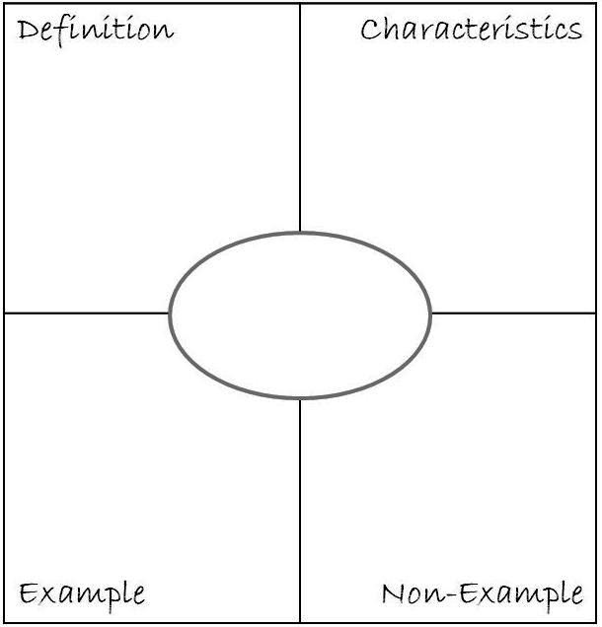
Common Core Standards for Mathematical Practice
Directions
Silently read about your assigned math practice
Unpack the practice standard with the Frayer Model
Collaboratively chart your math practice Frayer Model
Be ready to share with the larger group
Notes:
Instructor Notes: 20 minutes
Review slide.
Assign each table team one of the three math practices, MP1, MP3, or MP4.

Slide 10
MP2 Reason abstractly and quantitatively.
Definition
Characteristics
Explain the meaning of numbers, words, pictures, symbols, tables, graphs, and concrete objects. | contextualize & decontextualize, in & out of context
Singapore bar model, “What do the numbers used in the problem represent?” “This shows…” | “Ours is not to reason why, just invert and multiply.”
MP2
Example
Non-Example
Notes:
Instructor Notes: 30 seconds
Each team will have 1 minute to present salient characteristics of their assigned Math Practice. I’ll model once again what the share out might look like.
Please turn to the Math Practice 2 Frayer model in your handout.
Review slide

Slide 11
MP1 Make sense of problems and persevere in solving them.
Productive Struggle: “Students are more likely to retain what they learn when they expend effort solving problems that are within reach and grappling with key mathematical ideas that are comprehensible but not yet well formed.”
Carnegie Foundation for the Advancement of Teaching 2013
Notes:
Instructor Notes: 2 minutes
Give MP1 team/s 1 minute to present their chart/s.
Participants should record ideas on their CC Standard for Mathematical Practice handout
(click) What teacher actions make this quote a reality?

Slide 12
MP1 Make sense of problems and persevere in solving them.
Definition
Characteristics
Work to make sense of your problem. Make a plan. Try different approaches. | productive struggle strategy, planning, effort, not giving up
How many different plans do you have in your group? Explain them. I can do it. Sí, se puede. I think I can. I think I can. I think I can… | I quit.
MP1
Example
Non-Example
Notes:
Hidden slide with sample participant answers.
For facilitator use only.

Slide 13
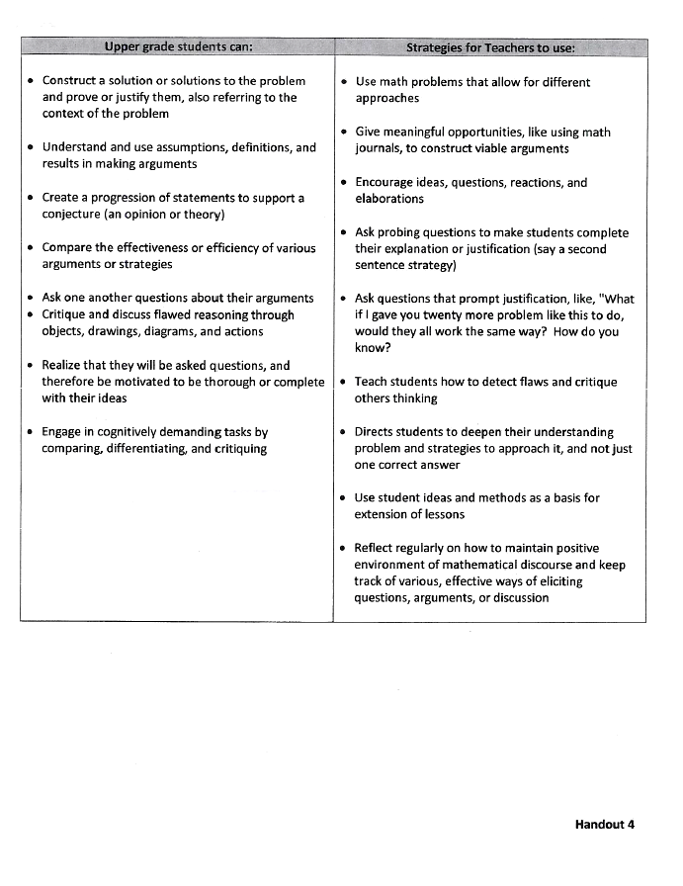
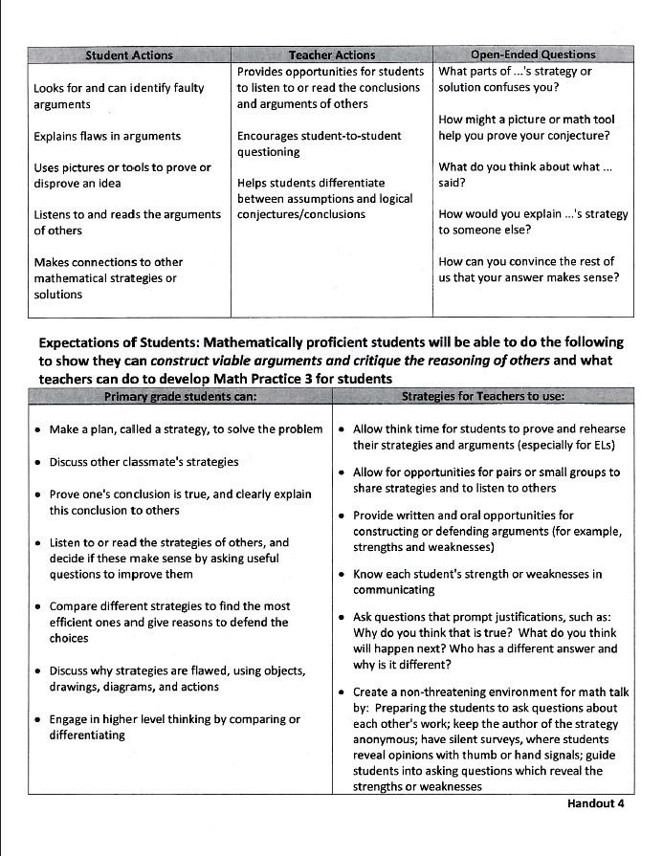
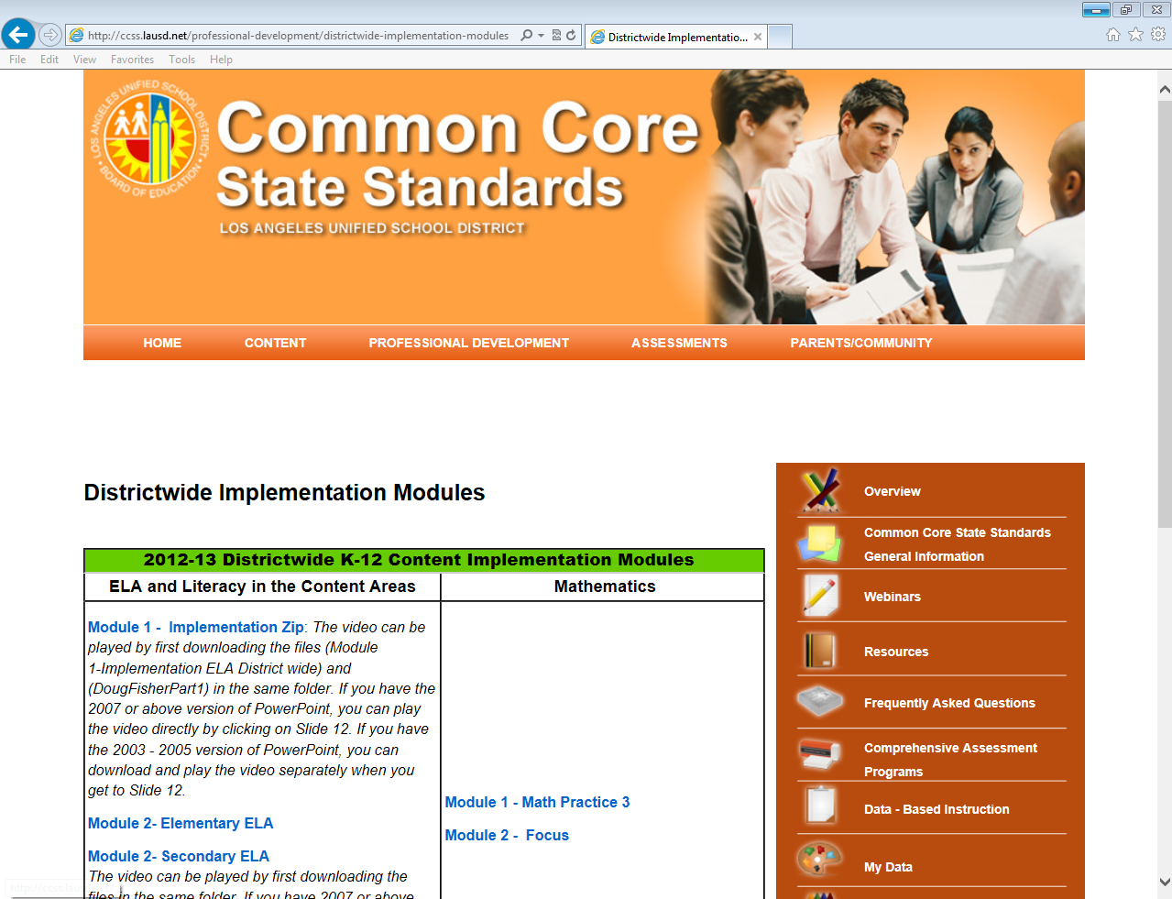
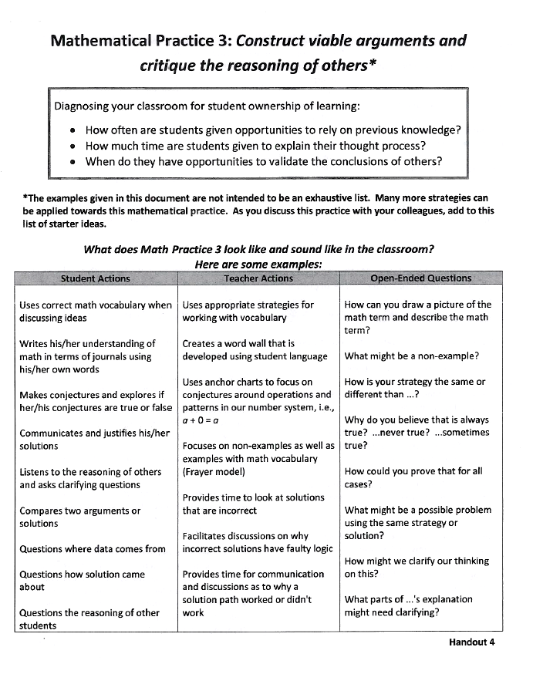
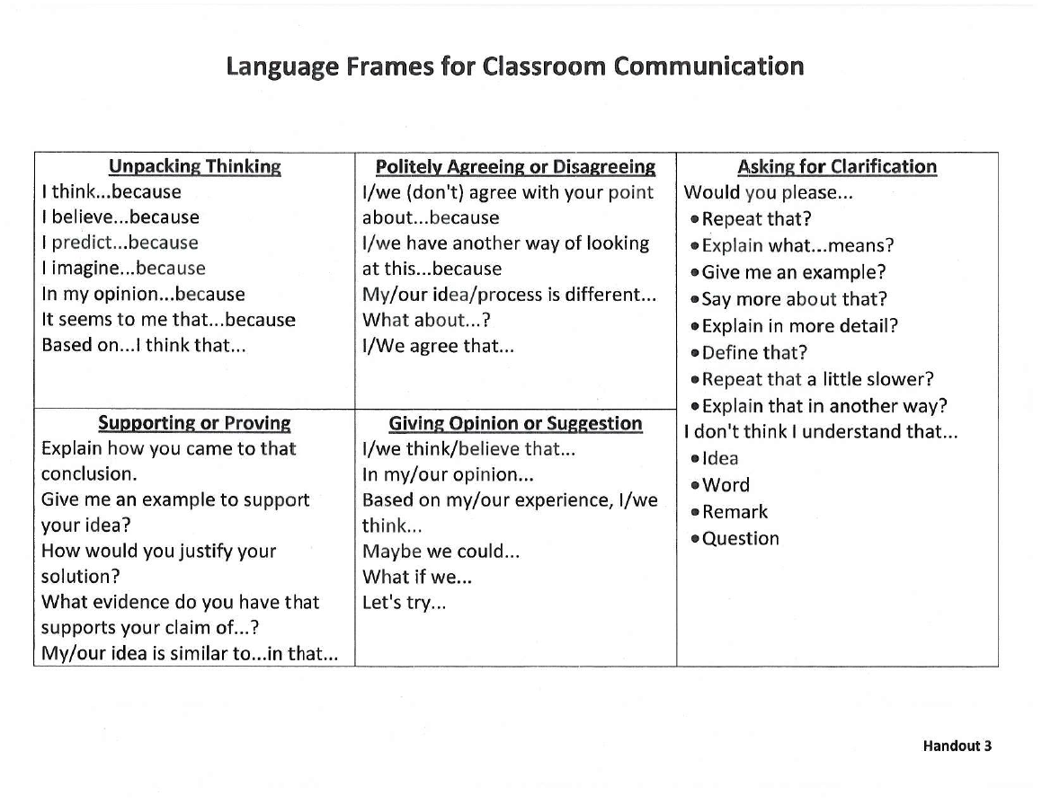
MP3 Construct viable arguments and critique the reasoning of others.
Notes:
Instructor Notes: 2 minutes
Give MP3 team/s 1 minute to present their chart/s.
Participants should record ideas on their CC Standard for Mathematical Practice handout
(click) Under the Professional Development tab on the ccss.lausd.net site you’ll find Math Module 1 – Math Practice 3.
The module comes with handouts that cover language frames for classroom communication and primary and upper grade MP3 look fors (What student actions should we see? What teacher actions should we see?)

Slide 14
MP3 Construct viable arguments and critique the reasoning of others.
Definition
Characteristics
Explain both what to do and why it works. Work to make sense of others' mathematical thinking. | communicate, back it up, prove it
I agree with Paco, because… I see it a different way… What evidence do you see to support…? What I hear you saying is… | a silent classroom
MP3
Example
Non-Example
Notes:
Hidden slide with sample participant answers.
For facilitator use only.

Slide 15
MP4 Model with mathematics.
“In life and work, you meet new situations so you need to learn how to handle problems that are not just like those you have tackled before.”
Burkhardt 2006
Notes:
Instructor Notes: 2 minutes
Give MP4 team/s 1 minute to present their chart/s.
Participants should record ideas on their CC Standard for Mathematical Practice handout
(click) What are some ways this quote relates to mathematical modeling, math practice 4?

Slide 16
MP4 Model with mathematics.
Definition
Characteristics
Apply mathematical ideas to real-world situations. Use mathematical models to solve problems. | real-world, graphs, drawings, tables, symbols, numbers, diagrams
concept lessons: Puppy Playpen, Snackers, Star Bars, Cookie Containers, Off to the Races… | drill & kill
MP4
Example
Non-Example
Notes:
Hidden slide with sample participant answers.
For facilitator use only.

Slide 17
MP7 Look for and make use of structure.
Definition
Characteristics
See and understand how numbers and shapes are organized and put together as parts and wholes. | operating, dissecting, discovering, deconstruct, decompose & compose
112 is 11 tens & 2 ones, 1 hundred & 12 ones, 1 hundred, 1 ten & 2 ones… | teaching the algorithm without connections
MP7
Example
Non-Example
Notes:
Instructor Notes: 30 seconds
Review slide

Slide 18
MP8 Look for and express regularity repeated reasoning.
Definition
Characteristics
Use patterns and structures to create and explain rules and shortcuts. Use the rules and shortcuts to solve problems. | shortcuts
“Will the same strategy always work?” | starting from scratch, no looking back
MP8
Example
Non-Example
Notes:
Instructor Notes: 30 seconds
Review slide

Slide 19
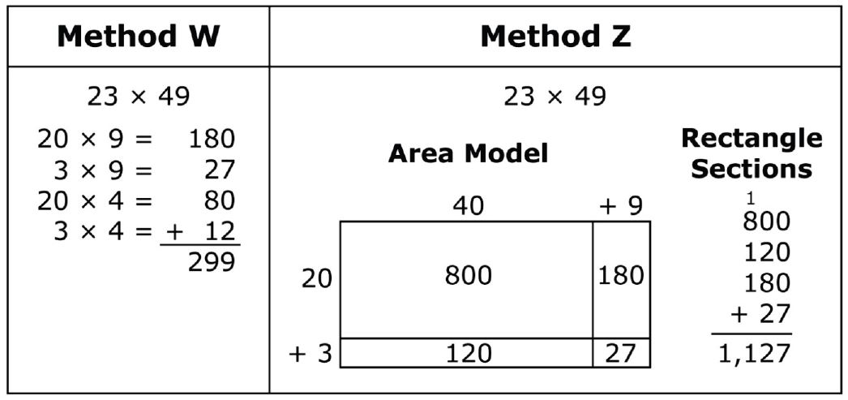
What evidence of math practices 1, 3, and/or 4 do you see in this sample Smarter Balanced Assessment Consortium item?
Pablo solved a multiplication problem using two different methods. He made a mistake in either Method W or Method Z.
SBAC
Grade 4
Sample
Extended Response
Identify the method where Pablo made a mistake and explain what he should do to correct it. Type your answer in the box below.
Notes:
Instructor Notes: 2-3 minutes
Possible observations:
Student would need to read through text and analyze two solution paths which requires perseverance. (MP1)
Students are asked to critique Pablo’s solution and explain their thinking. (MP3)
While not a real-world context, students need to understand the partial products area model that Pablo used in Method Z. (MP4)

Slide 20
What are the implications of this SBAC item for classroom instruction?
Pablo solved a multiplication problem using two different methods. He made a mistake in either Method W or Method Z.
SBAC
Grade 4
Sample
Extended Response
Identify the method where Pablo made a mistake and explain what he should do to correct it. Type your answer in the box below.
Notes:
Instructor Notes: 2-3 minutes
Possible observations:
Students need to talk about each other’s thinking (not just their own), and eventually write about it. (MP3)
English learners need to get time, encouragement, and support – from other students/teacher – in using academic language. Support need to include scaffolds such as sentence frames, multiple choice oral responses, and reference to diagrams, and other representations. (MP3, MP4, MP6)
Student work needs to include revisions, especially revised explanations and justifications. Misconceptions as well as correct solutions need to be critiqued. (MP1, MP3)
Multiple solution paths to problems need to be elicited from students. (MP1)
A conceptual understanding of multiplication based on place value is needed in grade 4. (MP7)

Slide 21
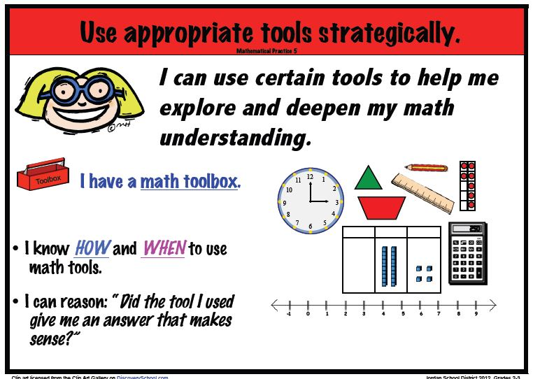
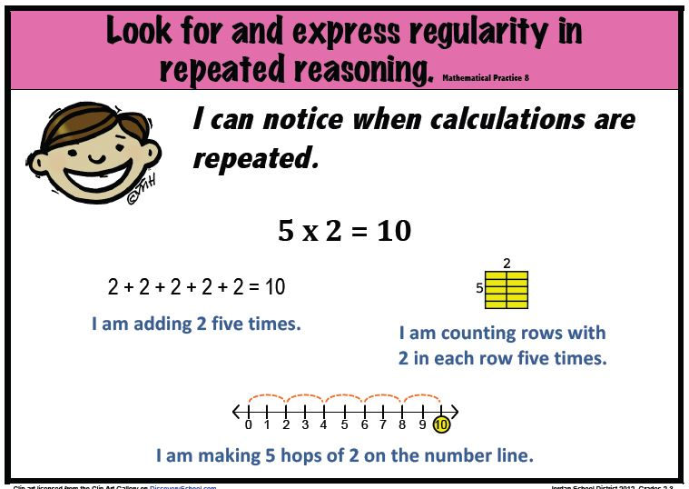
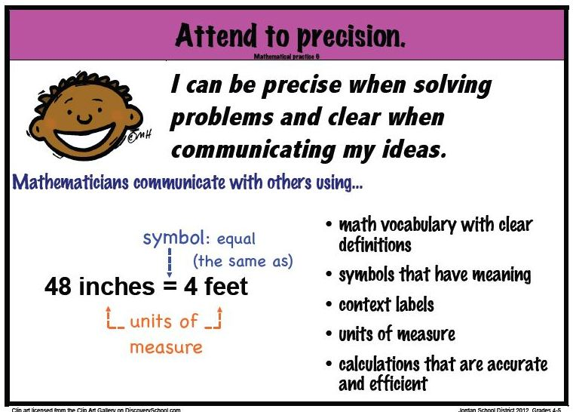
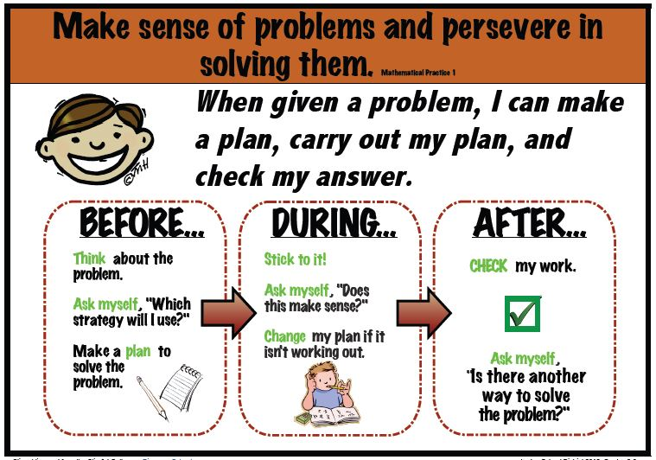
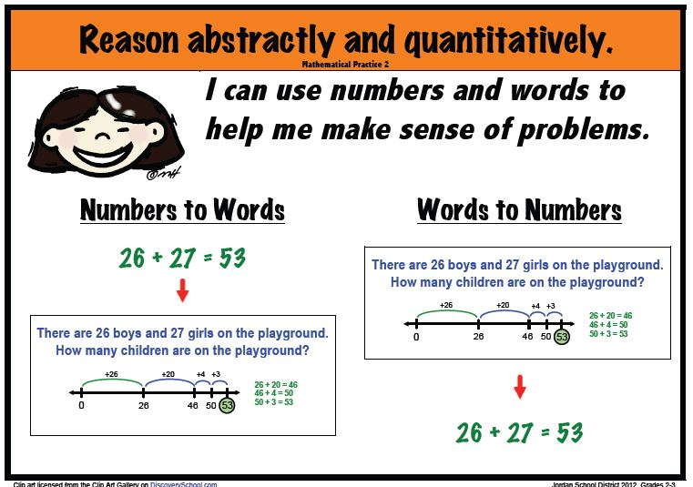
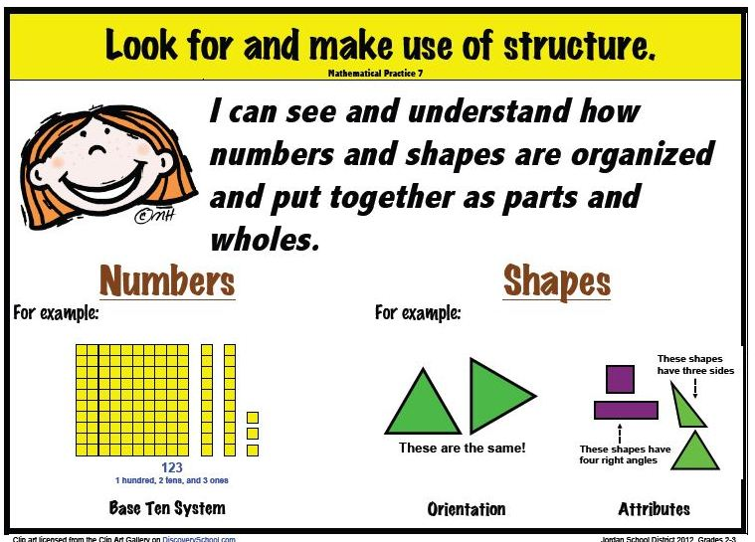
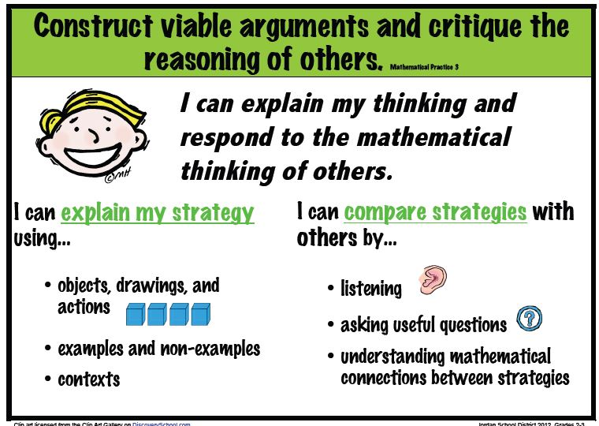
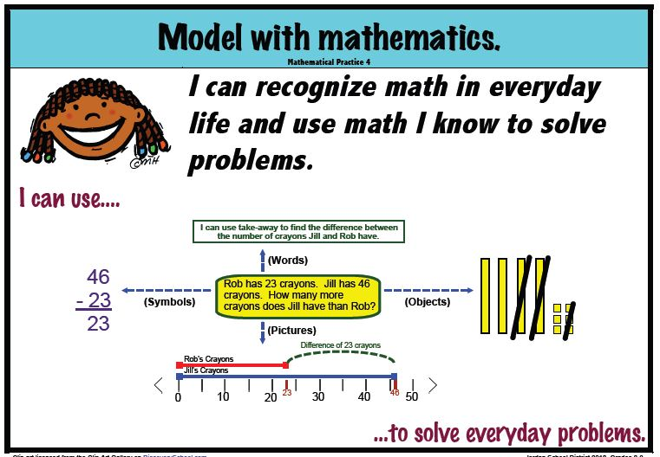
Common Core Standards for Mathematical Practice
Jordan School District
Notes:
Instructor Notes: 30 seconds
Here are some fun visuals for each of the Standards for Mathematical Practice. If you Google “Jordan School District Mathematical Practices,” you’ll find a link to these kid-friendly representations.
http://elemmath.jordandistrict.org/mathematical-practices-by-standard/

Slide 22
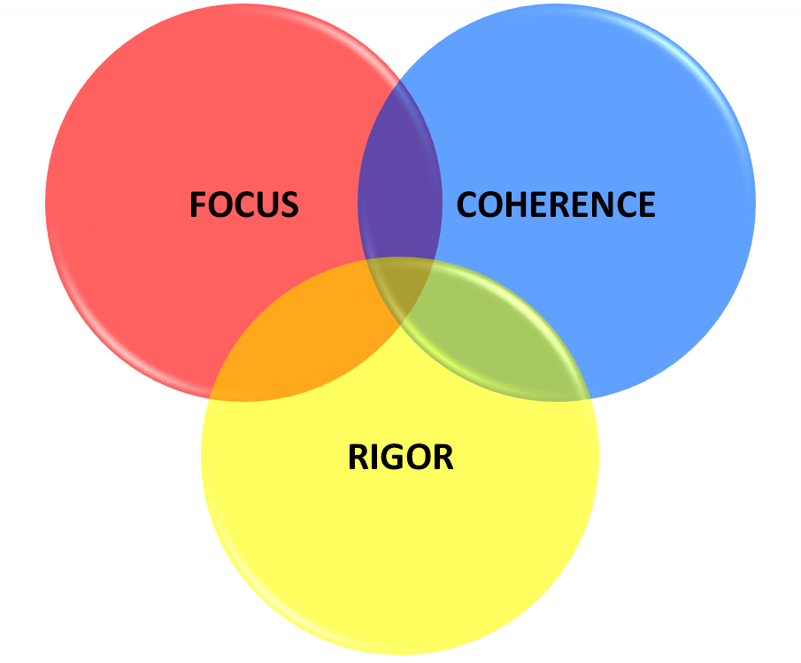
CCSSM Instructional Shifts
Focus: Instruction is focused on grade level standards.
Practice standards help us to focus deeply on what is emphasized in the content standards, so that students gain strong foundations.
Notes:
Instructor Notes: 30 seconds
One of the District 2013-14 math goals is to continue to understand and use the Common Core instructional shift “Focus.”
Focus is about significantly narrowing the scope of content and deepening how time and energy is spent in the math classroom.
Review slide

Slide 23
CCSSM Instructional Shifts
Coherence: Instruction should be attentive to learning across grades and linking major topics within grades.
Analyzing practice standards in vertical teams supports communication and unity in message across grades.
Notes:
Instructor Notes: 30 seconds
Another District 2013-14 math goals is to begin to understand and use the Common Core instructional shift “Coherence.”
Review slide

Slide 24
CCSSM Instructional Shifts
Rigor: Instruction should develop conceptual understanding, procedural skill and fluency, and application.
Skills without conceptual understanding are meaningless. Conceptual understanding without skills is inefficient.
Without problem solving, skills and conceptual understanding have no utility. - NCTM
Notes:
Instructor Notes: 30 seconds
Another District 2013-14 math goal is to begin to understand and use the Common Core instructional shift rigor.
Review slide
Additional Facilitator Information:
The Hunt Institute
Mathematics Fluency: A Balanced Approach
http://www.youtube.com/watch?v=ZFUAV00bTwA&list=PLD7F4C7DE7CB3D2E6&index=13
The Balance Between Skills and Understanding http://www.youtube.com/watch?v=5dUQtIXoptY&list=PLD7F4C7DE7CB3D2E6&index=17

Slide 25
Session Outcome
Collaboratively define Common Core Standards for Mathematical Practice 1, 3, and 4
Notes:
Instructor Notes: 30 seconds
Review slide

Slide 26
Thank You
College and Career Readiness

